Slide 1

CCS 2023
赵路路
2024.6.28

Slide 2
Contents
Recall to Payment Channel
Abstract
Introduction
Accio Scheme
Randomizable Signature of Updatable Commitments (RSUC)
Experiments & Conclusion

Slide 3
Contents
Recall to Payment Channel
Abstract
Introduction
Accio Scheme
Randomizable Signature of Updatable Commitments (RSUC)
Experiments & Conclusion

Slide 4
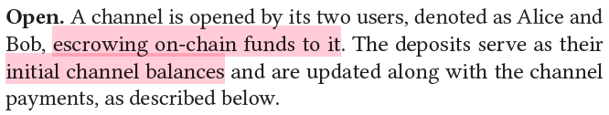
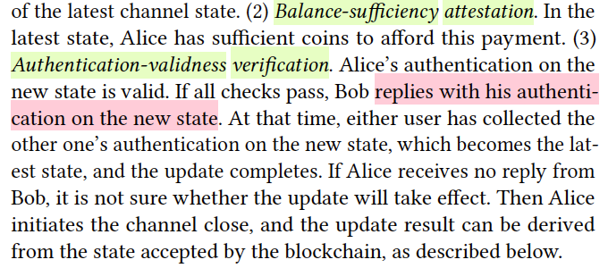
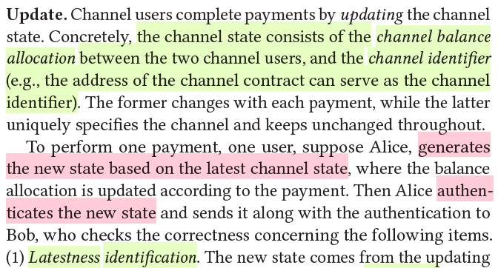
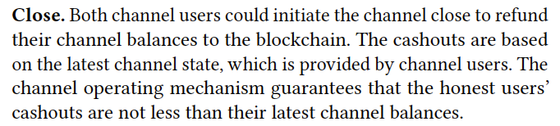
Recall to Payment Channel
Low Scalability: 7 Payments per Second with 1 Hour Confirmation

Slide 5
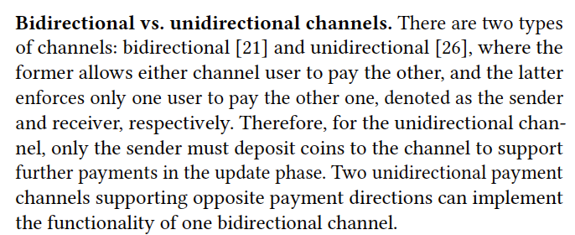
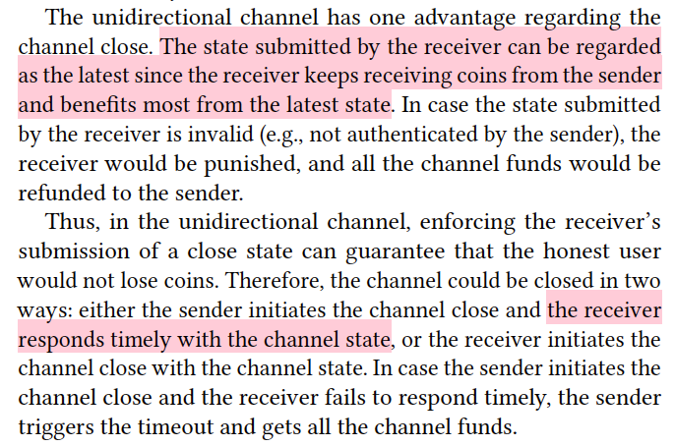
Recall to Payment Channel
Bidirectional vs. Unidirectional

Slide 6
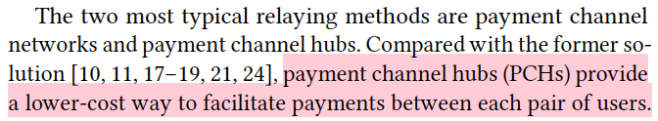
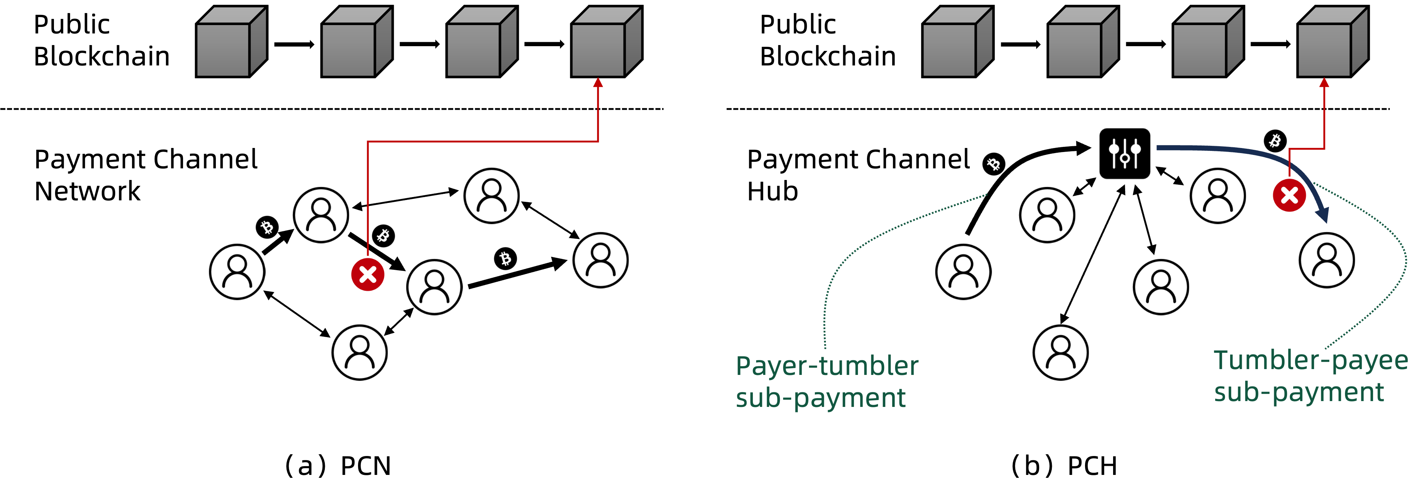
Recall to Payment Channel
Payment Channel Hubs vs. Payment Channel Networks

Slide 7
Contents
Recall to Payment Channel
Abstract
Introduction
Accio Scheme
Randomizable Signature of Updatable Commitments (RSUC)
Experiments & Conclusion

Slide 8
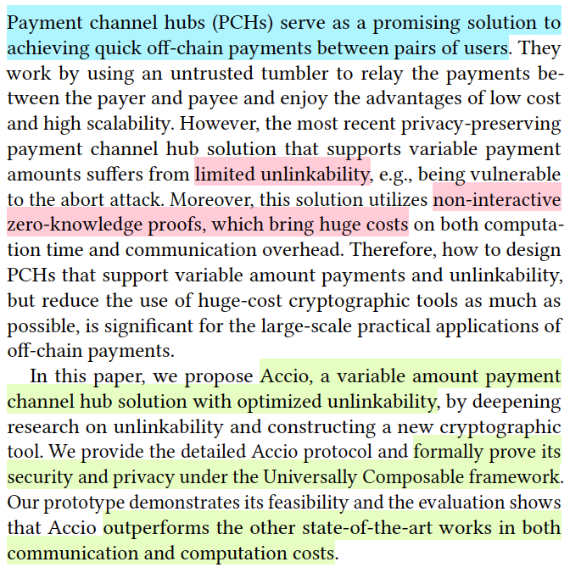
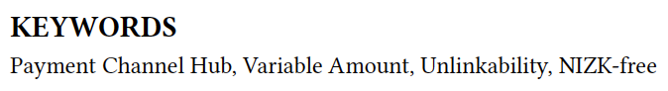
Abstract
Accio: Variable Amount, Optimized-Unlinkability, NIZK-Free PCH

Slide 9
Contents
Recall to Payment Channel
Abstract
Introduction
Accio Scheme
Randomizable Signature of Updatable Commitments (RSUC)
Experiments & Conclusion

Slide 10
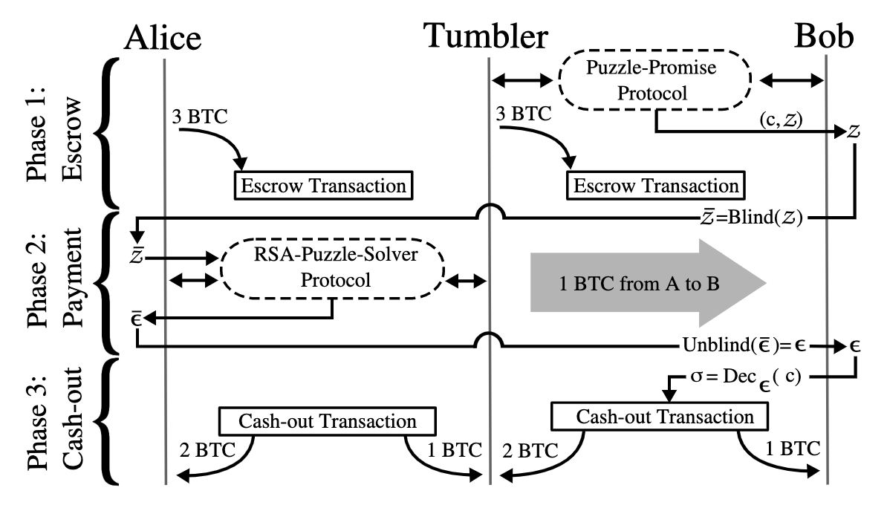
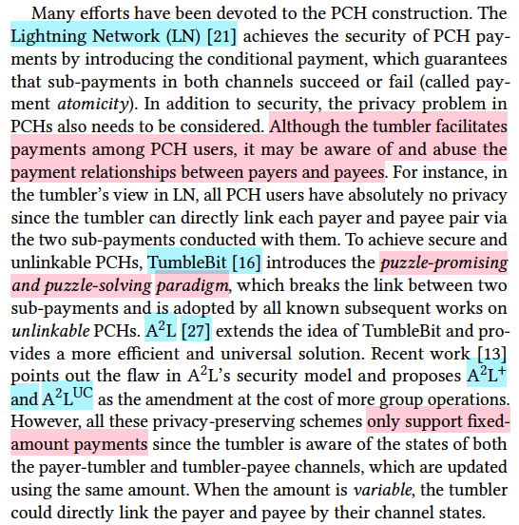
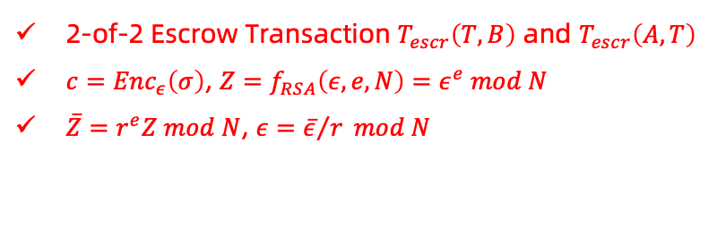
Introduction
2-of-2 Escrow Transaction $T_{escr}\left(T,B\right)$ and $T_{escr}\left(A,T\right)$
$c={Enc}_{ε}\left(σ\right)$, $Z=f_{RSA}\left(ε,e,N\right)=ε^{e} mod N$
$\overline{Z}=r^{e}Z mod N$, $ε={\overline{ε}}/r mod N$
Technological Route (Fixed)

Slide 11
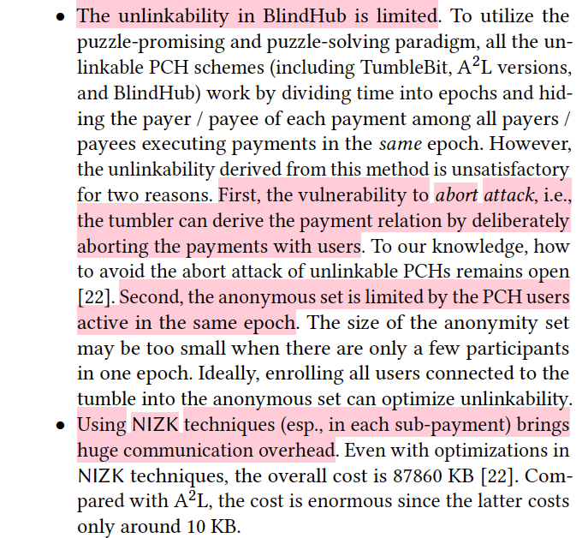
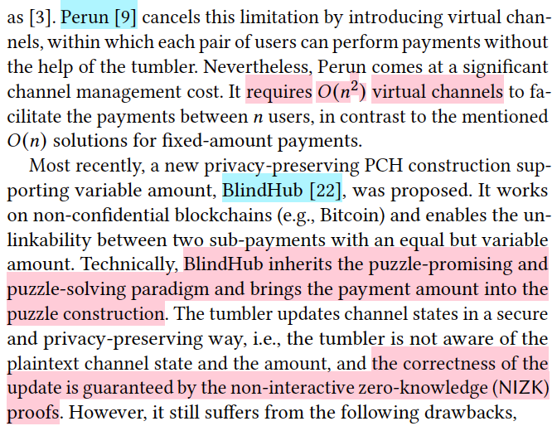
Introduction
Technological Route (Variable)

Slide 12
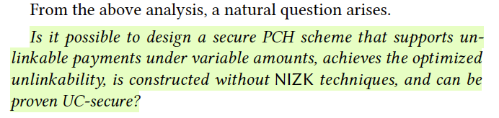
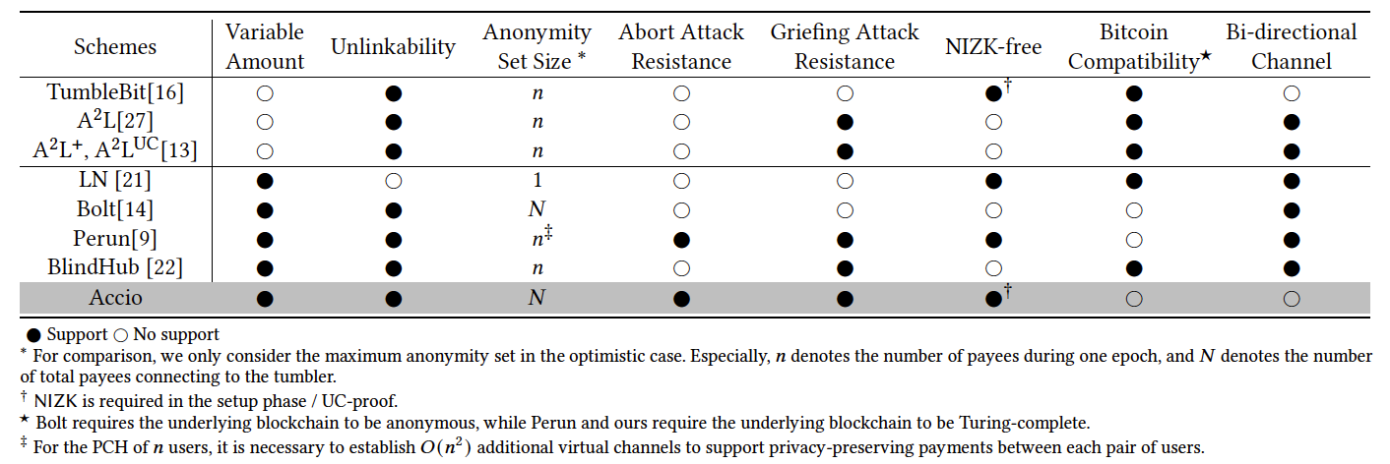
Introduction
Motivations

Slide 13
Contents
Recall to Payment Channel
Abstract
Introduction
Accio Scheme
Randomizable Signature of Updatable Commitments (RSUC)
Experiments & Conclusion

Slide 14
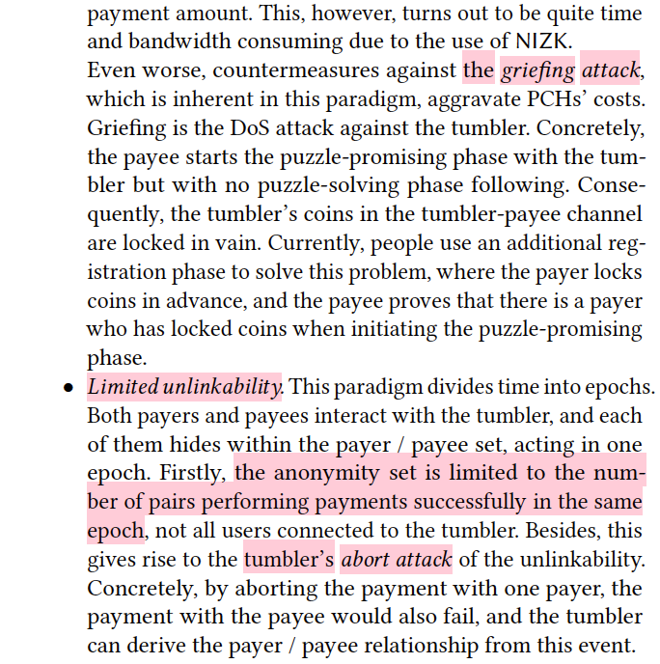
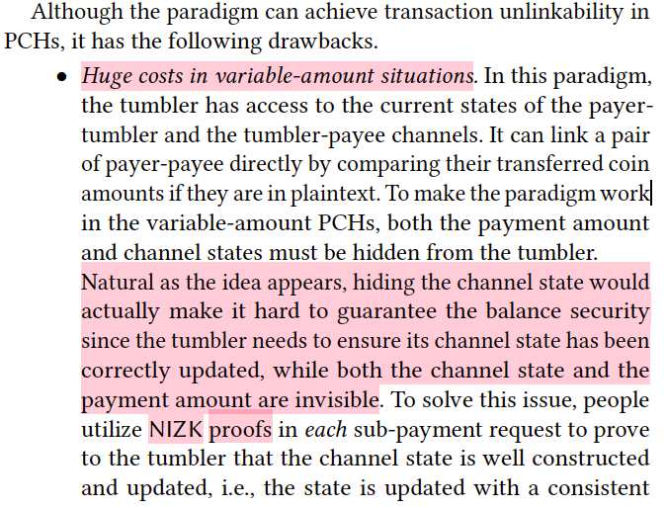
Accio Scheme
Necessity in Replacing the Paradigm

Slide 15
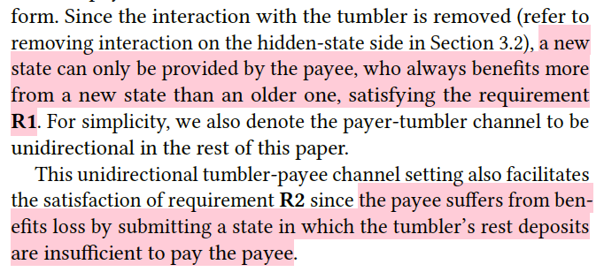
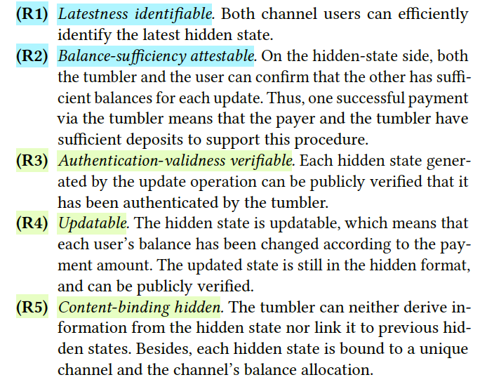
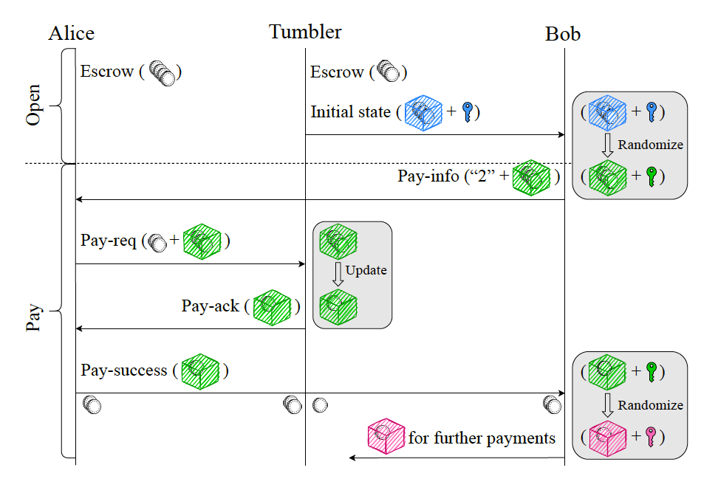
Accio Scheme
Requirements

Slide 16
Contents
Recall to Payment Channel
Abstract
Introduction
Accio Scheme
Randomizable Signature of Updatable Commitments (RSUC)
Experiments & Conclusion

Slide 17
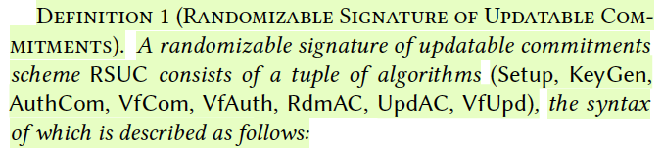
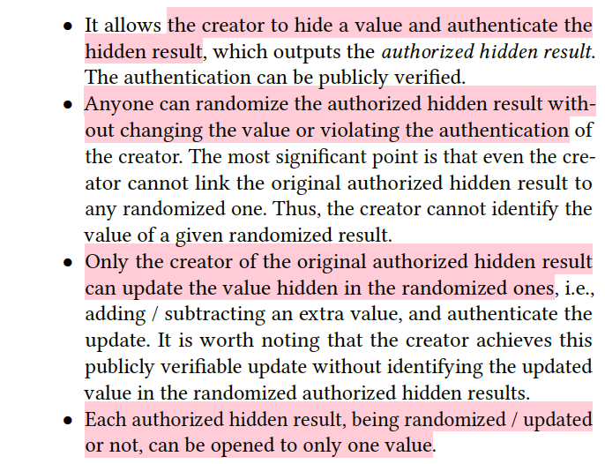
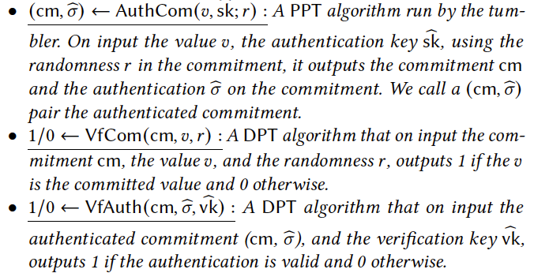
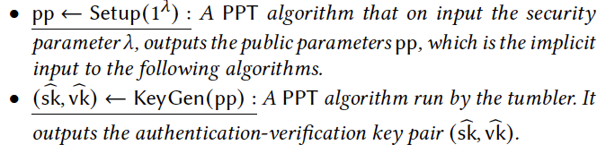
Randomizable Signature of Updatable Commitments (RSUC)
Functionality and Primitives

Slide 18
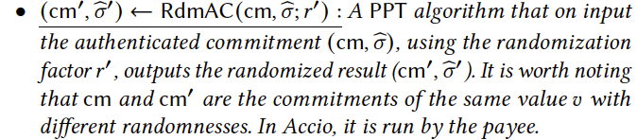
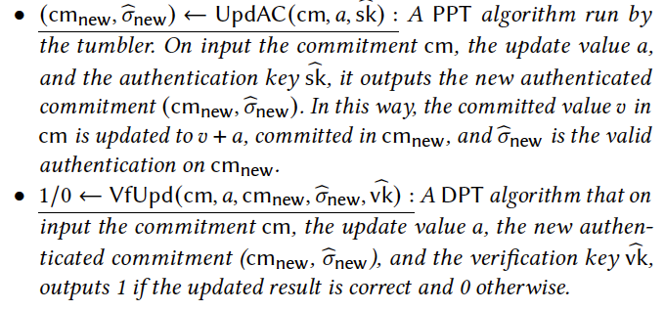
Randomizable Signature of Updatable Commitments (RSUC)
Functionality and Primitives

Slide 19
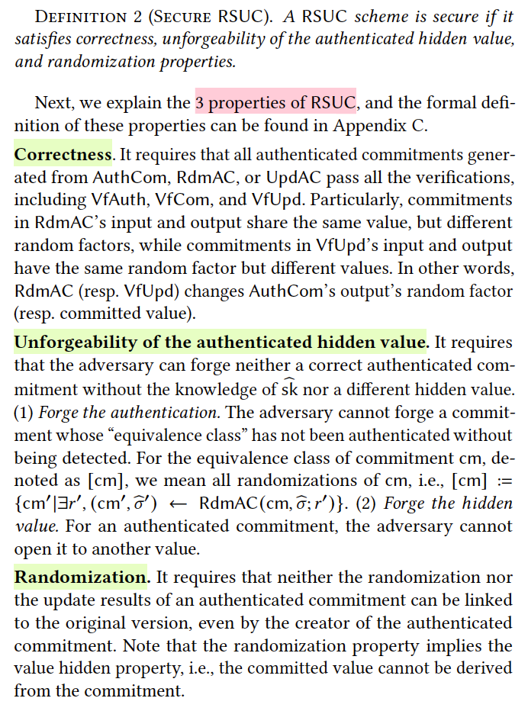
Randomizable Signature of Updatable Commitments (RSUC)
Properties

Slide 20
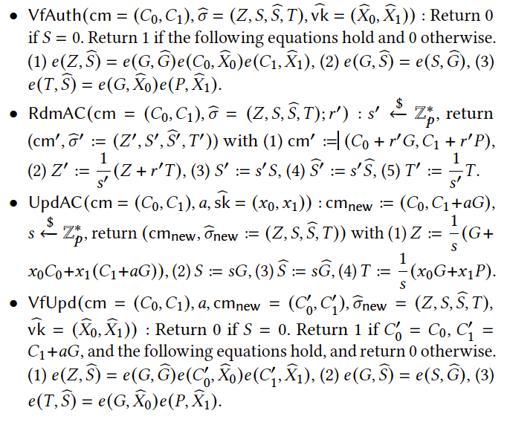
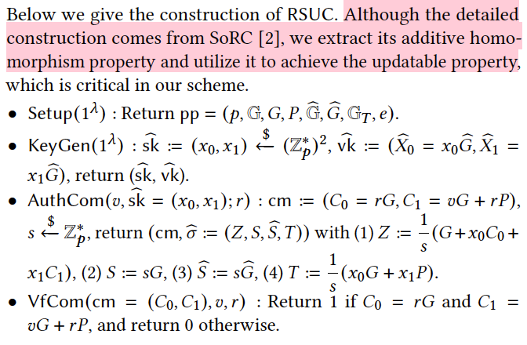
Randomizable Signature of Updatable Commitments (RSUC)
Instance Construction
[2] Balthazar Bauer and Georg Fuchsbauer. 2020. Efficient Signatures on Randomizable Ciphertexts. In Security and Cryptography for Networks, SCN, Vol. 12238. Springer, 359–381.

Slide 21
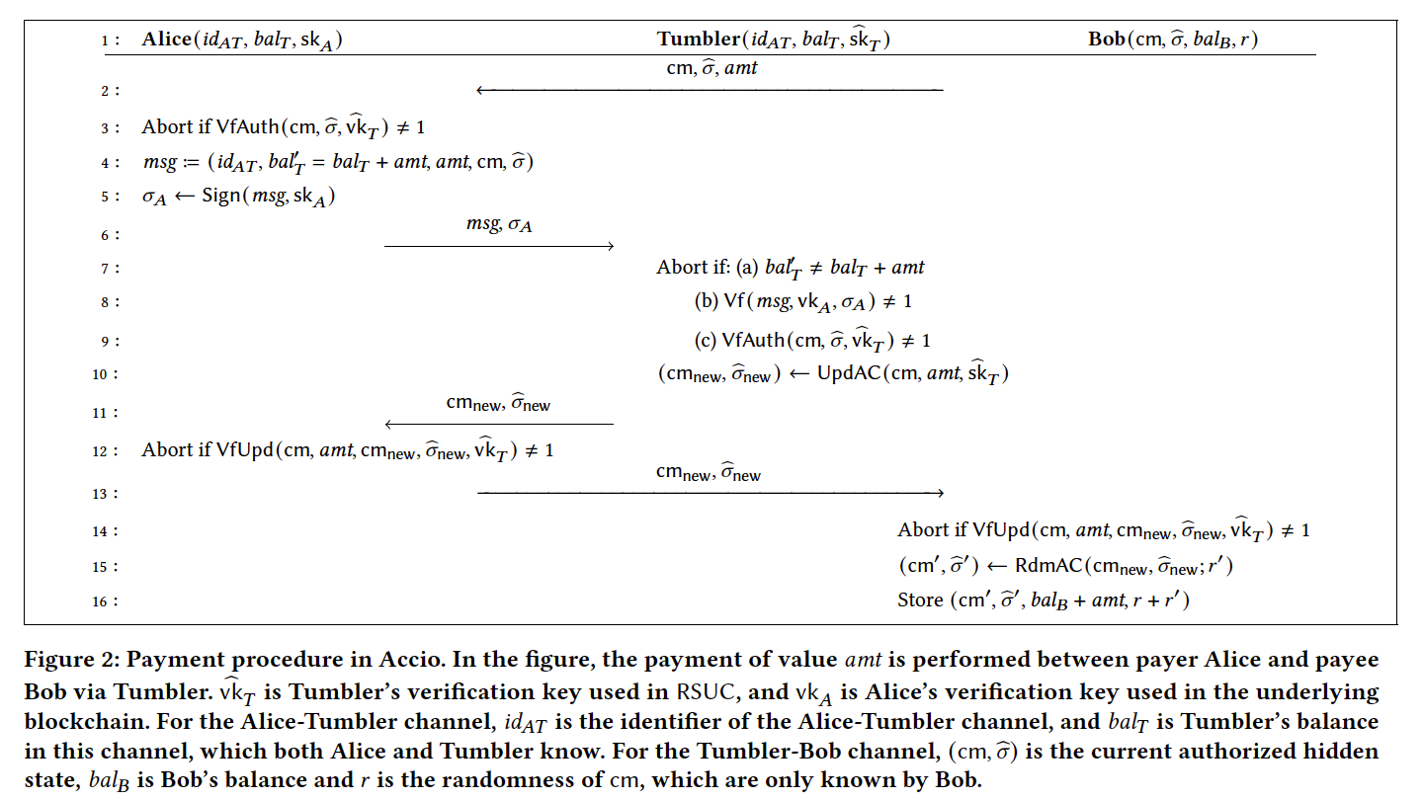
Randomizable Signature of Updatable Commitments (RSUC)

Slide 22
Contents
Recall to Payment Channel
Abstract
Introduction
Accio Scheme
Randomizable Signature of Updatable Commitments (RSUC)
Experiments & Conclusion

Slide 23
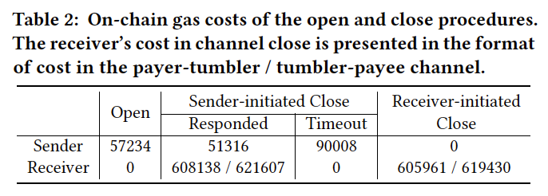
Experiments & Conclusion
On-Chain Cost
Environment | Value
Blockchain | Ethereum
Language | Solidity
Curve | BN-128

Slide 24
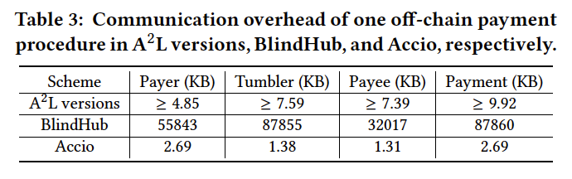
Experiments & Conclusion
Off-Chain Cost
Environment | Value
Library | MCL
Curve | BN-128
CPU | 3.20GHz AMD 5800H
Cores | 8
Memory | 40GB
OS | Ubuntu 22.0.4.1 LTS

Slide 25
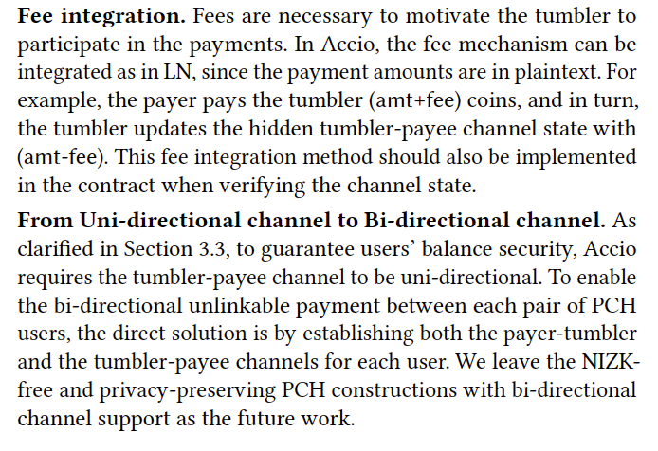
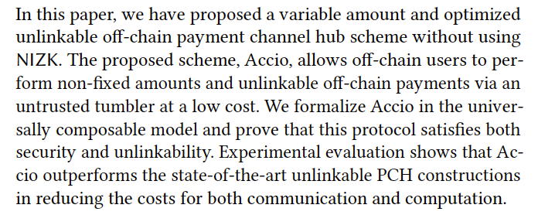
Experiments & Conclusion
Conclusion

Slide 26
Thanks! Questions?

